Slide 1
Capstone Project -1
Project Title: Global Terrorism Analysis Team Members Nitesh Mishra Rohit Sharma Abhishek Verma
Aditya Dhoundiyal

Slide 2
Contents
1- Problem Statement
2- Data Summary
3- Data Analysis
4- Charts
5- Challenges
6- Conclusion

Slide 3

Global Terrorism Analysis Database
The Global Terrorism Database (GTD) is an open-source database including information on terrorist attacks around the world from 1970 through 2017. The GTD includes systematic data on domestic as well as international terrorist incidents that have occurred during this time period and now includes more than 180,000 attacks. The database is maintained by researchers at the National Consortium for the Study of Terrorism and Responses to Terrorism (START), headquartered at the University of Maryland.

Slide 4
Problem Statement
. Explore the data
. Analyze the data
. Discover key findings pertaining to terrorist activities.

Slide 5
Data Summary
In this Global Terrorism Analysis dataset, there are 135 columns. Most columns contains missing values and also they are not much important. So, we are using important columns, these are iyear, imonth, iday, country_txt, provstate, region_txt, latitude, longitude, city, attacktype1_txt, nkill, nwound, gname, target1, targtype1_txt, weaptype1_txt’
The dataset ran over on terrorist attacks around the world from 1970 through 2017.

Slide 6
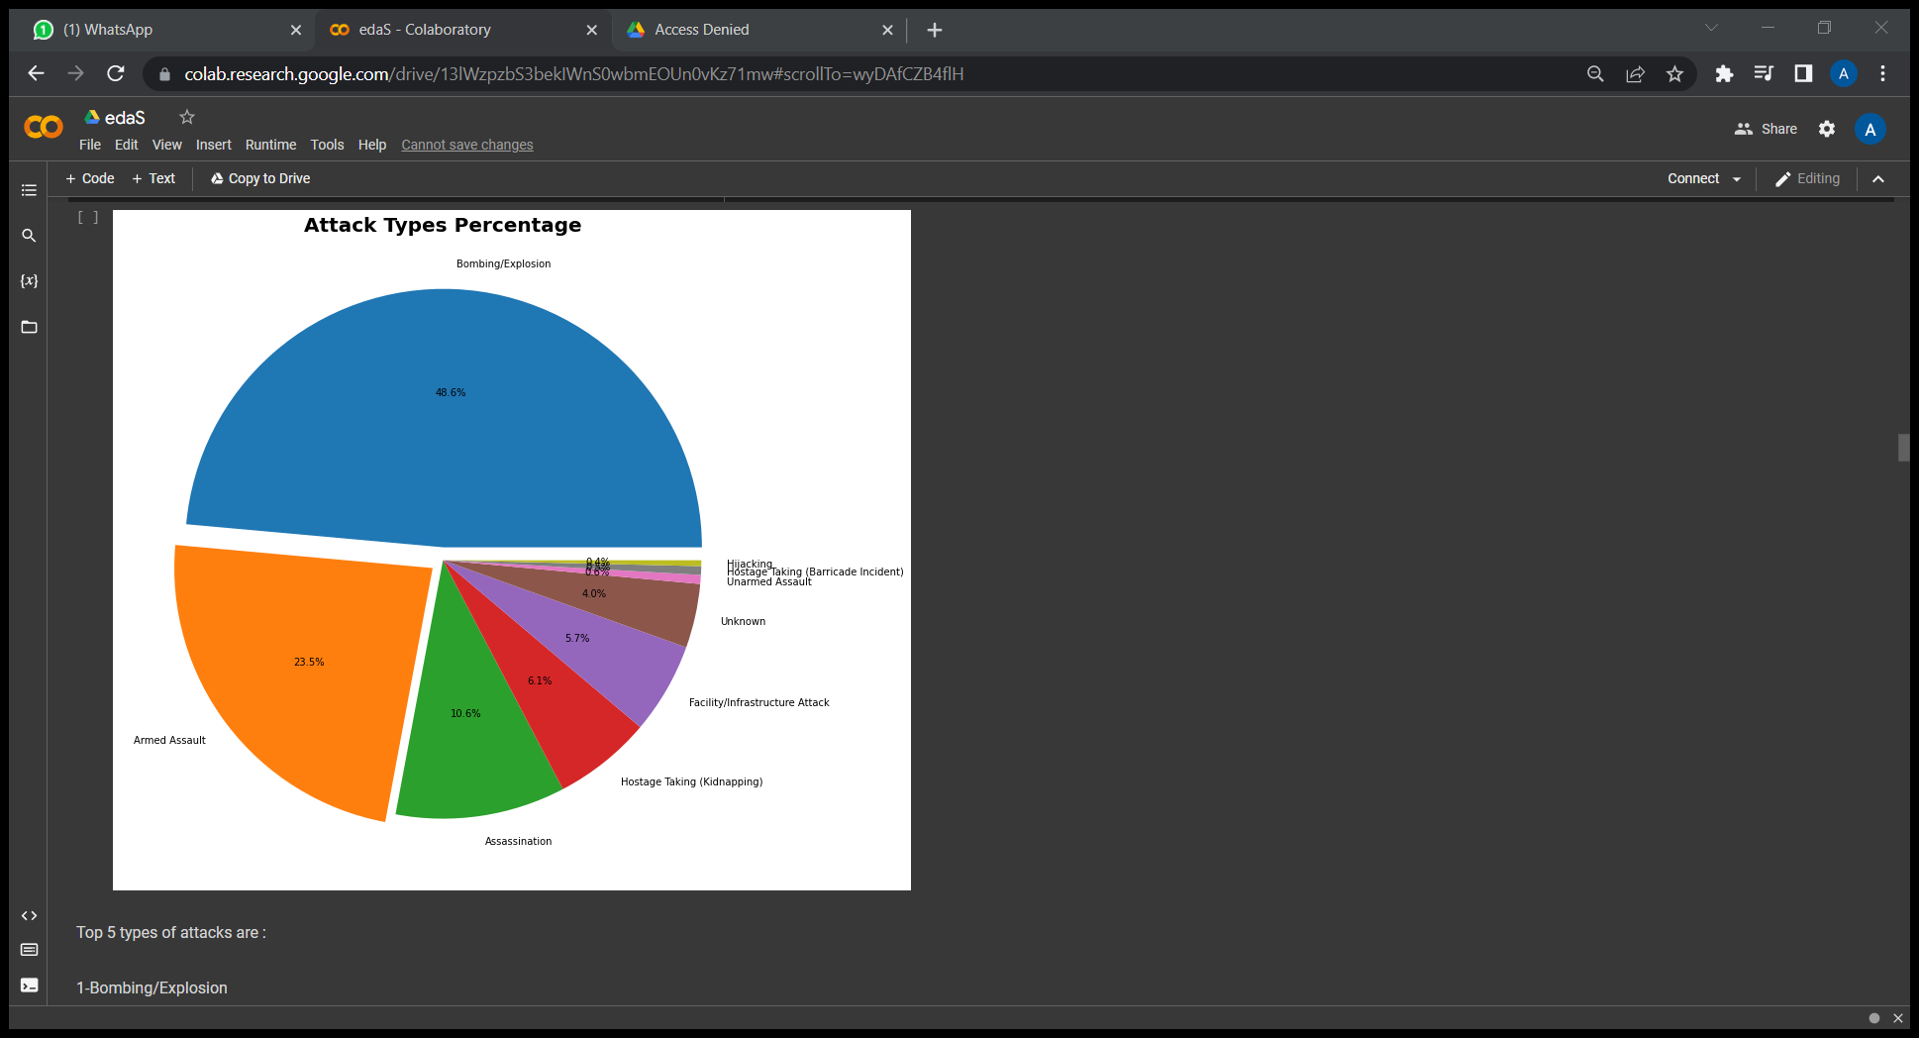
Different Types of Attacks
Top 5 types of attacks are :

Slide 7
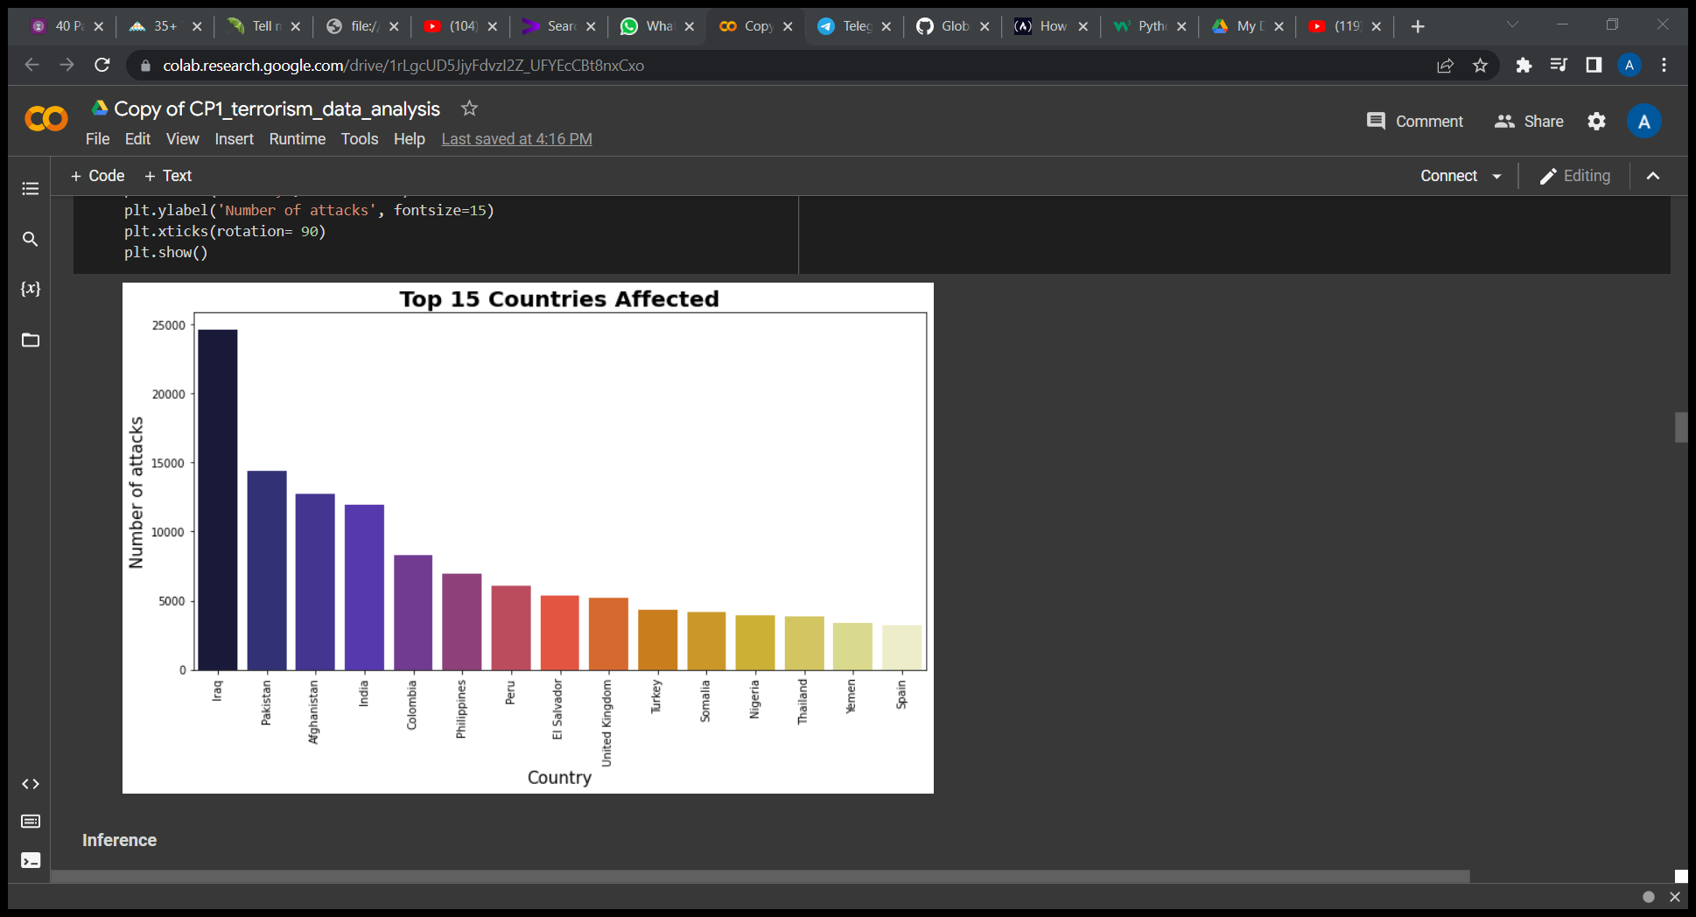
Top 15 Countries with most attacks

Slide 8
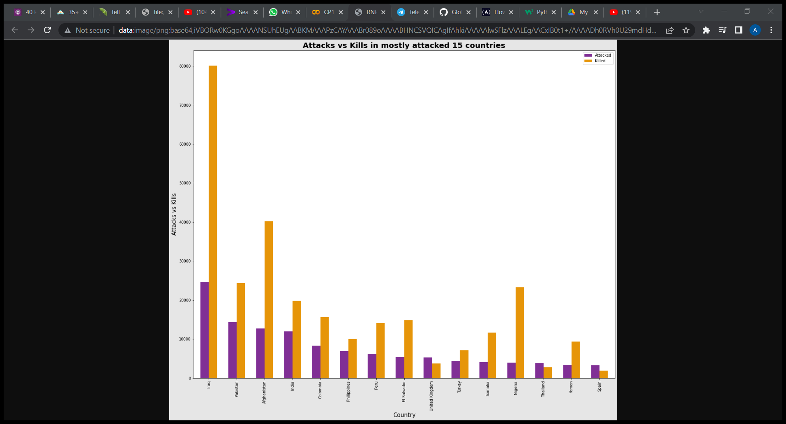
Comparing No. of Attacks with Killings for top 15 countries

Slide 9
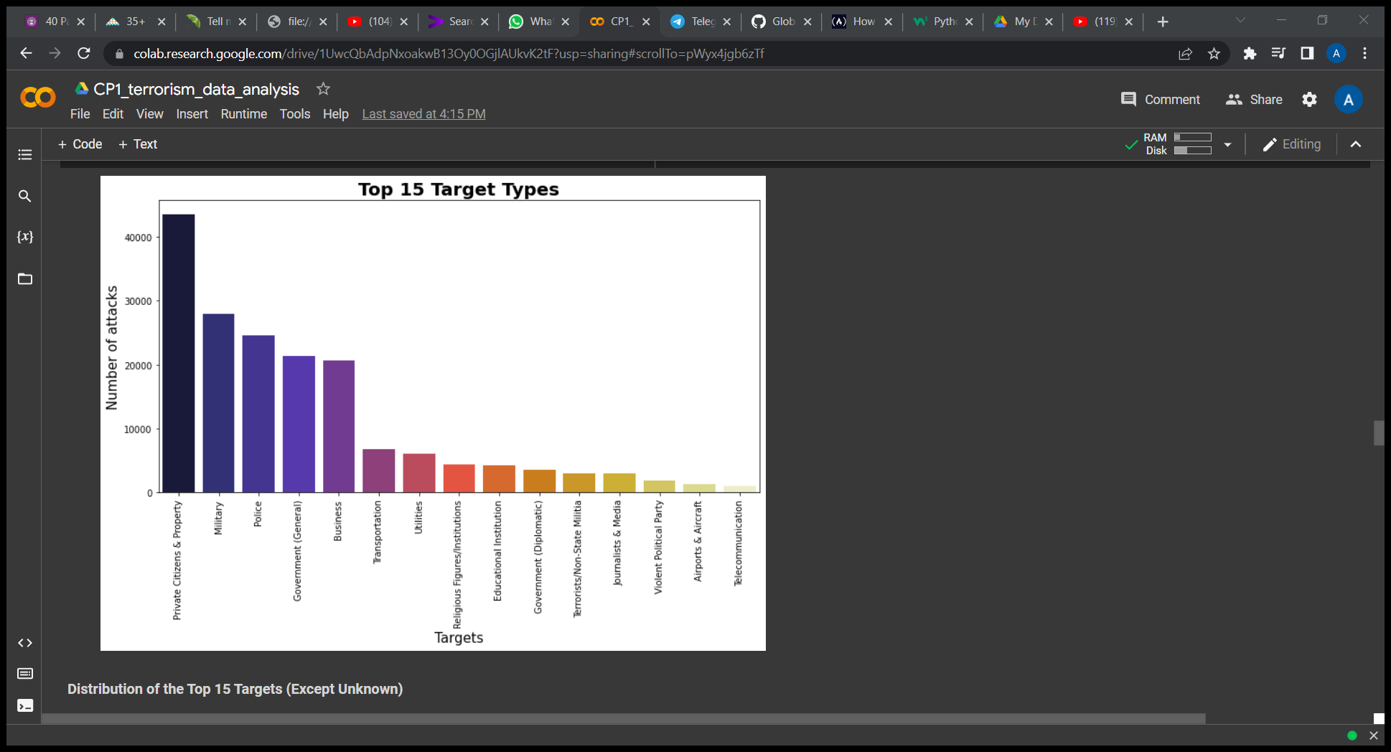
Top 15 Target Types

Slide 10
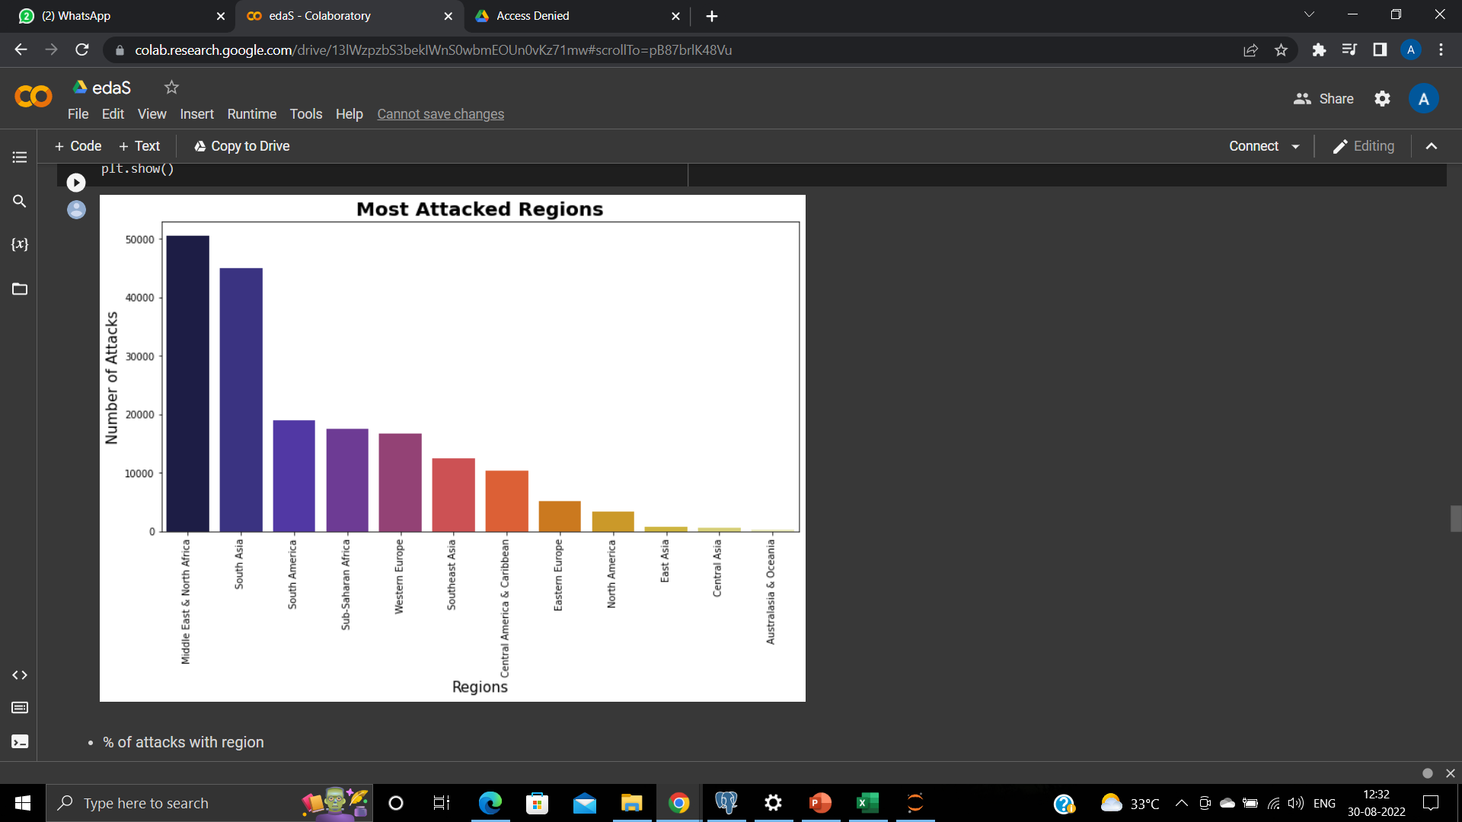
Most Attacked Regions

Slide 11
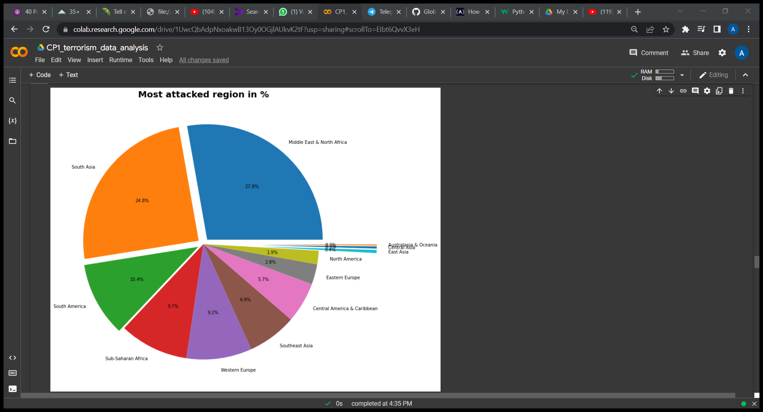
Percentage of attacks in regions

Slide 12
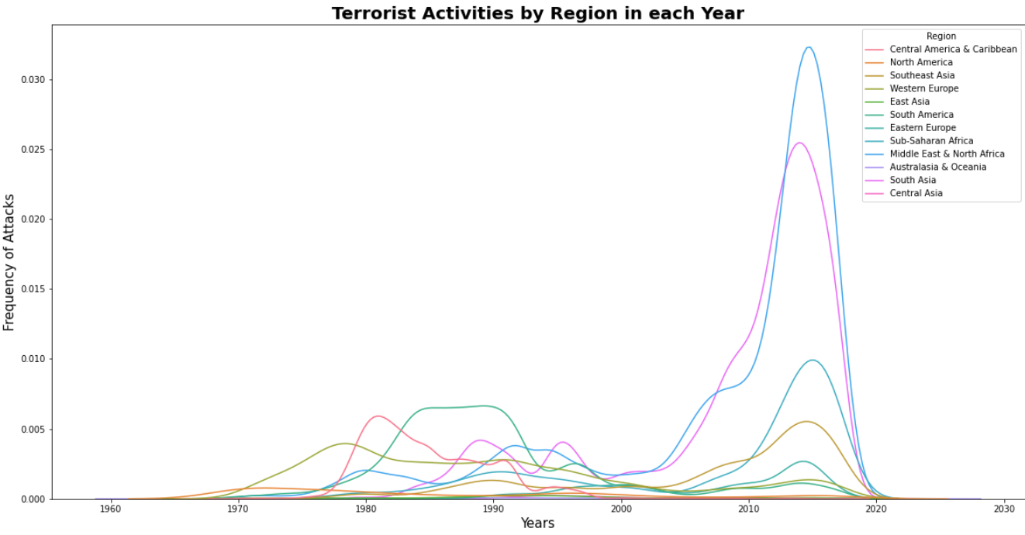
Terrorist Activities by Region in Each Year

Slide 13
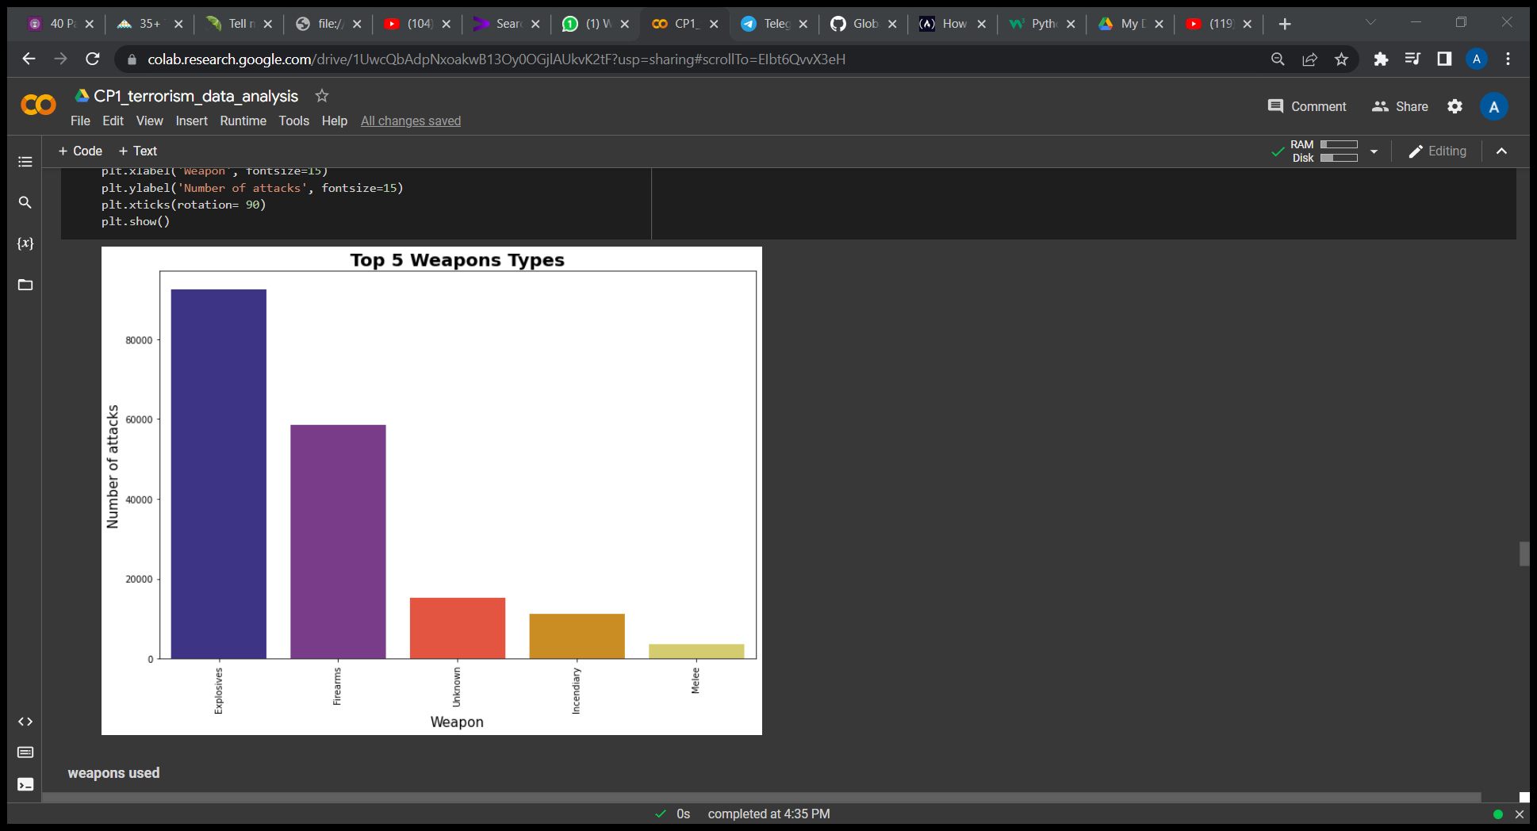
Top 5 Weapons Types

Slide 14
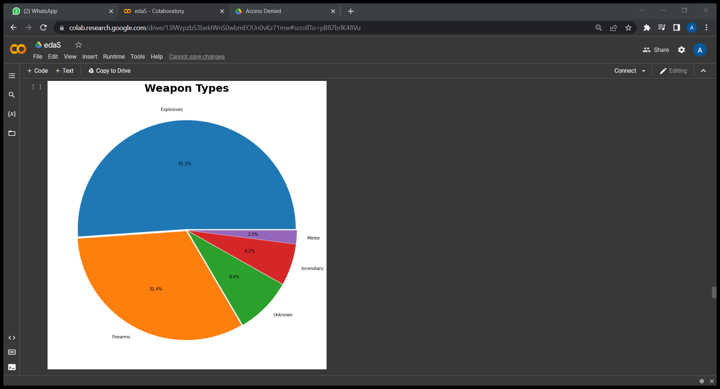
Percentage of Weapon Types

Slide 15
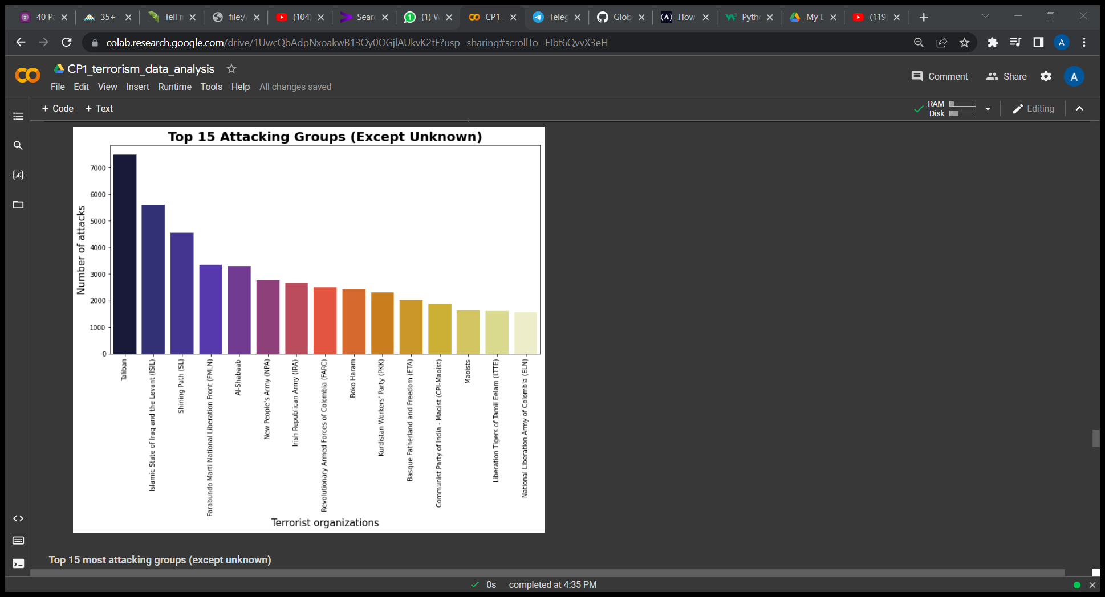
Top 15 Attacking Group

Slide 16
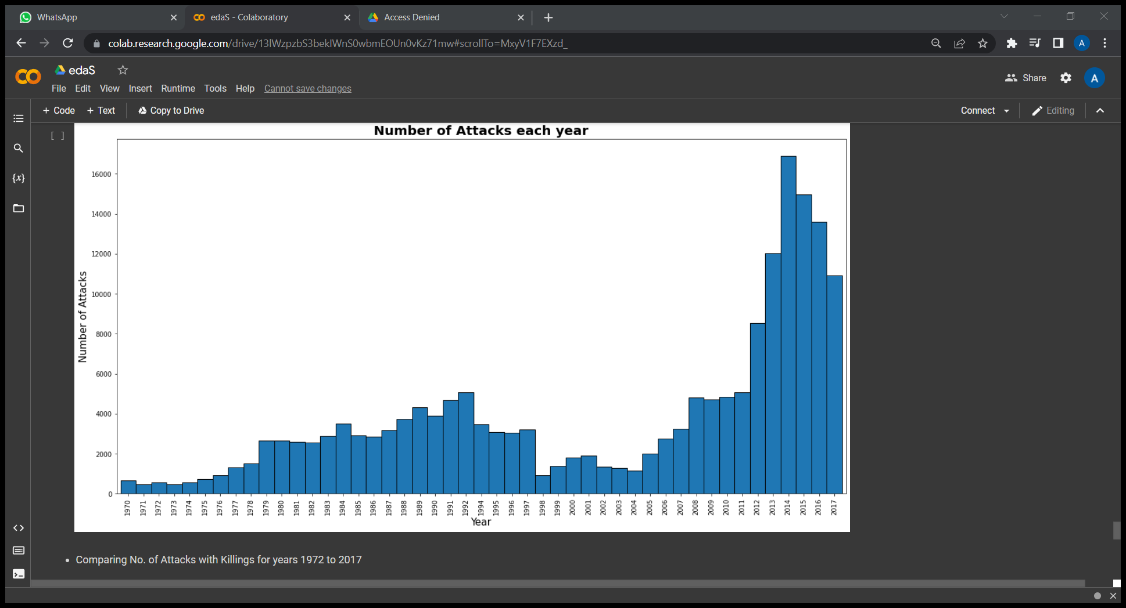
Numbers of Attack per Year

Slide 17
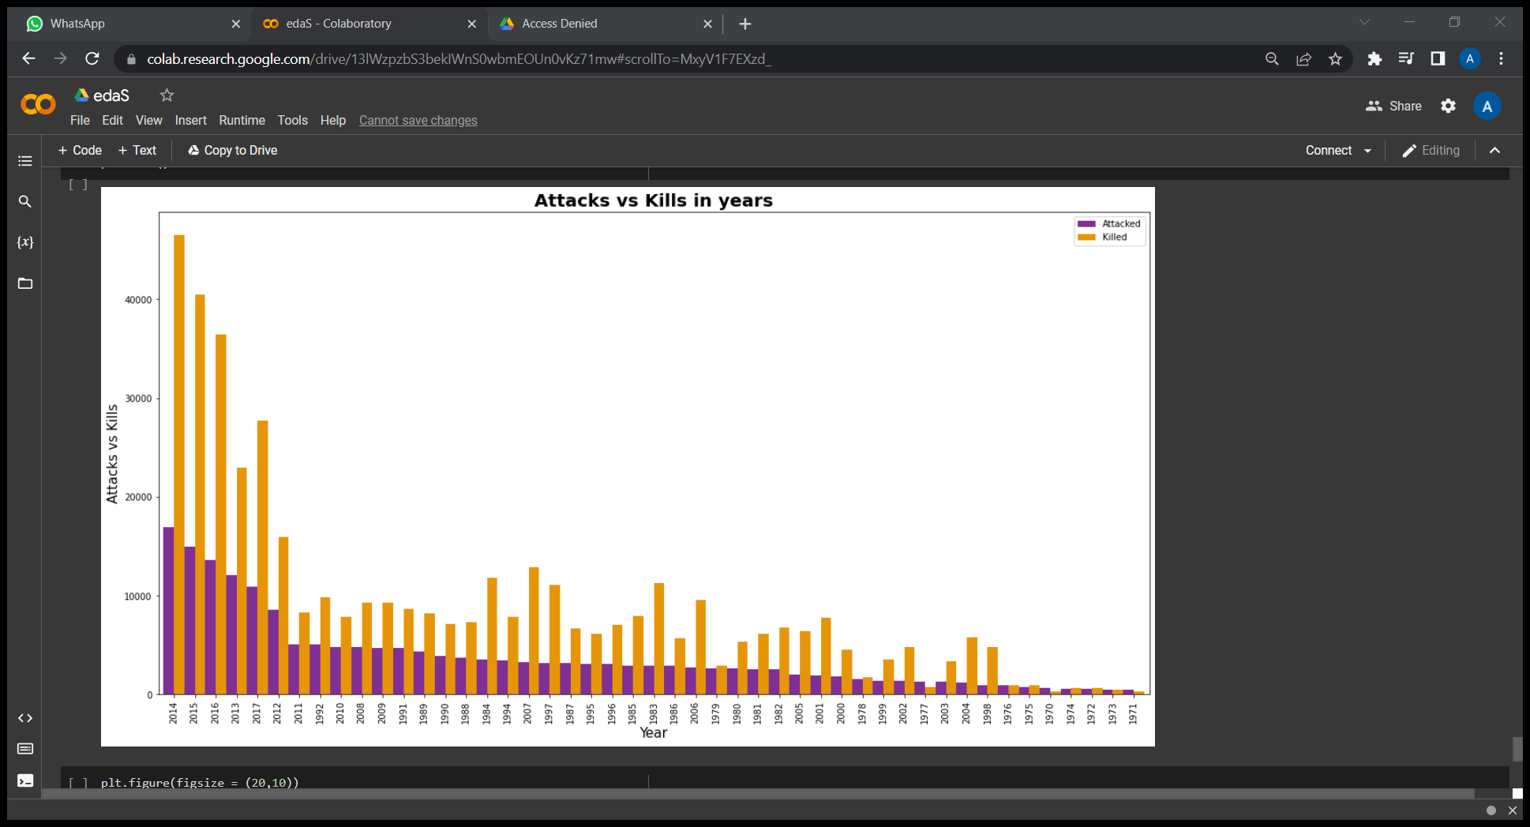
Attack vs Kills per Year

Slide 18
Challenges
1. The data is too big and it contains too many un useable columns.
2. There were also many null values in dataset.
3. The name of some columns are unmeaningful. So, changing name of columns in meaningful manner was also a challenge.
it contains too many useable columns which null values,

Slide 19
Conclusion
1 - The top 3 attack types are:
BOMBING/EXPLOSION,
ARMED ASSAULT,
ASSASSAINATION
2- The top 3 attack types in percentage:
Bombing/Explosion=48.6%
Armed Assault=23.5%
Assassination=10.6%
3- The top 3 countries and states are most attacks:
COUNTRIES = IRAQ, PAKISTAN, AFGANISTAN
STATES = BAGHDAD, NORTHERN IRELAND, BALOCHISTAN
4- Top 3 target type are:
Private Citizens & Property, Military, Police

Slide 20
Conclusion continued…
5- Top 3 attacked regions are in percentage:
Middle East & North Africa-27.8%,
South Asia-24.8%,
South America-10.4%
6- Top 5 weapons used are:
Explosives, Firearms, unknown, Incendiary, Mele
7- Top 3 terrorist groups:
Taliban,
Islamic State of Iraq and the Levant (ISIL),
Shining Path (SL)
8- The top 3 most attack and casualties in year are:
In 2014 number of casualties are 46534.
In 2015 number of casualties are 40463.
In 2016 number of casualties are 36427.

Slide 21
Conclusion continued…
9- The top 3 year and regions of highest terrorist activities:
In 2014, Middle East & North Africa Region.
In 2015, South Asia Region.
In 2014, South America Region.

Slide 22


Slide 23
Q & A

